Slide 1



Digital Marketing Specialist Graduation Project
Team Members
Doaa Fathi AbdelAziz
Heba Ahmed Hassan
Yassmin AbdEl-Maboud Nassar
Fatma Mohamed ElKerdawy
Shaimaa Aly Ahmed
GROUP INSTRUCTOR
ENG. SAFYELDIN AHMED

Slide 2


Introduction

Slide 3
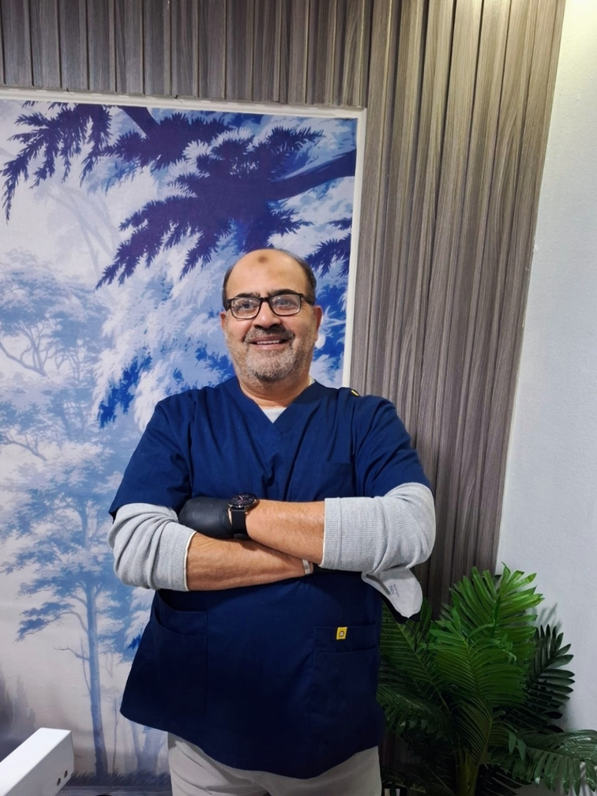
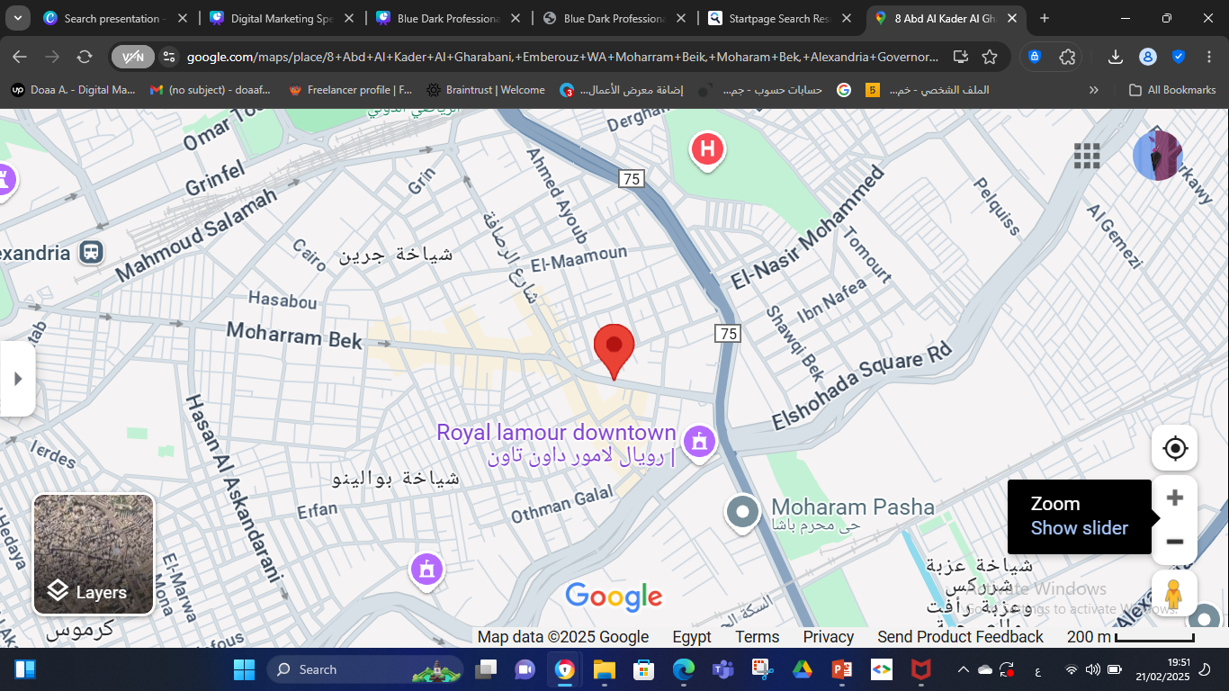
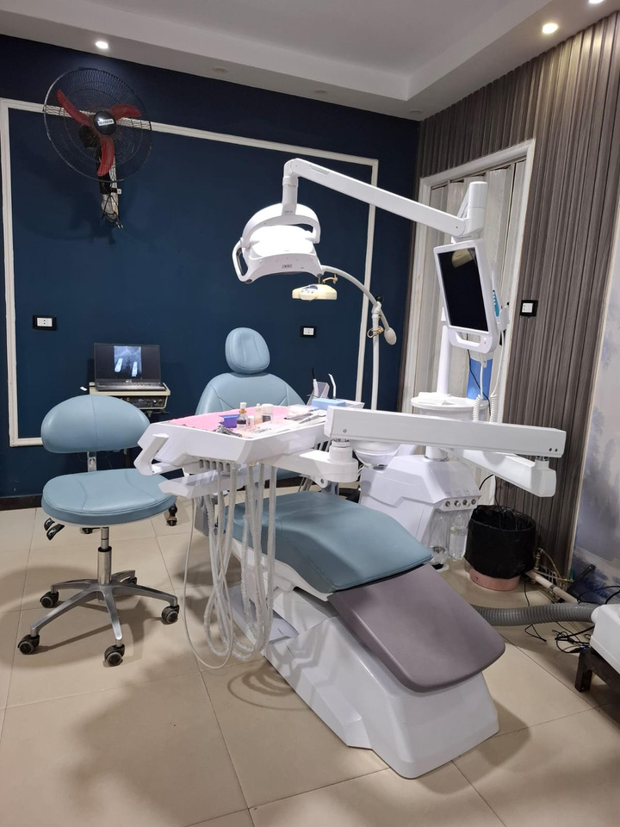
Introduction
We hold a digital marketing strategy for a Dental Clinic in Moharam-Bek , ALexandria for Dr. Ahmed Saeed Hammad, The page of the clinic was created on 2018 and was pause on 2019. We started working on the page starting from December 2024 to increase page followers and increase awareness.

Slide 4

VISION AND MISSION
VISION:
Our vision is to deliver advanced, patient-centered dental care in a welcoming and innovative environment.
MISSION
To establish a trusted digital presence that educates, engages, and builds long-term patient relationships while enhancing the clinic's reputation and achieving sustainable community growth.

Slide 5
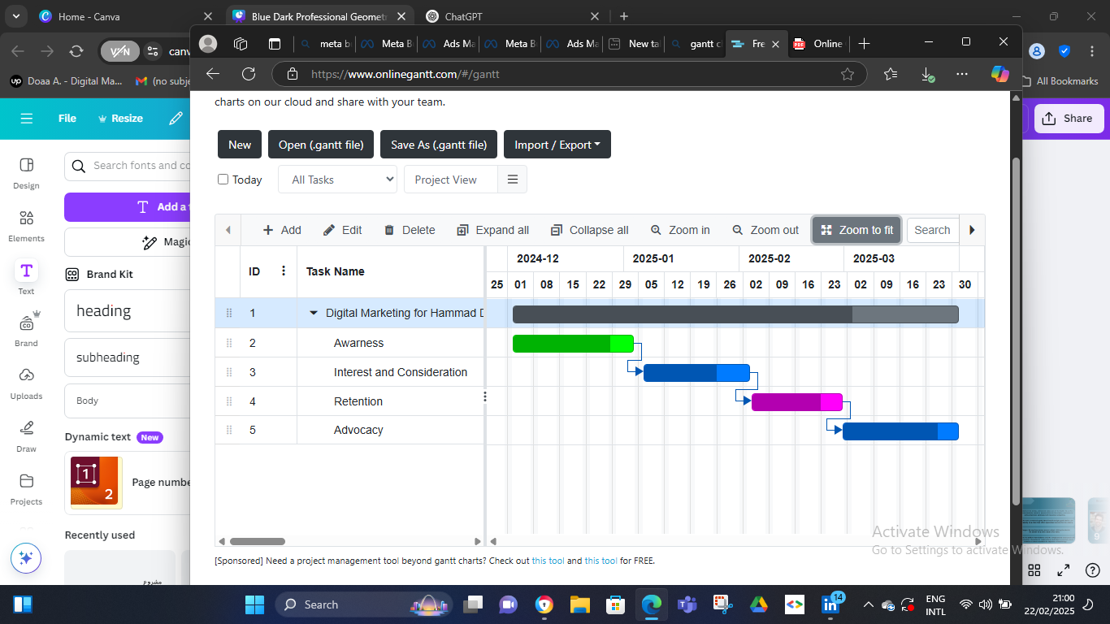

GANNT Chart

Slide 6
Situation Analysis

Slide 7
SWOT Analysis
S
W
STRENGTHS
WEAKNESSES
Trusted dentist with over 30 years of experience.
Strong patient rapport and a wide range of high-quality services.
Limited marketing effort
Gaps in patients feedback
Never make life posts or videos
0
T
OPPORTUNITIES
THREATS
Digital marketing will build strong online presence to attract more patients
Retargeting patients by refreshing the presence on social media
High competition from clinics with lower prices or higher technology or promotion
Patients in medium-level areas migh priorize cost over quality

Slide 8
BUYER PERSONA

Slide 9
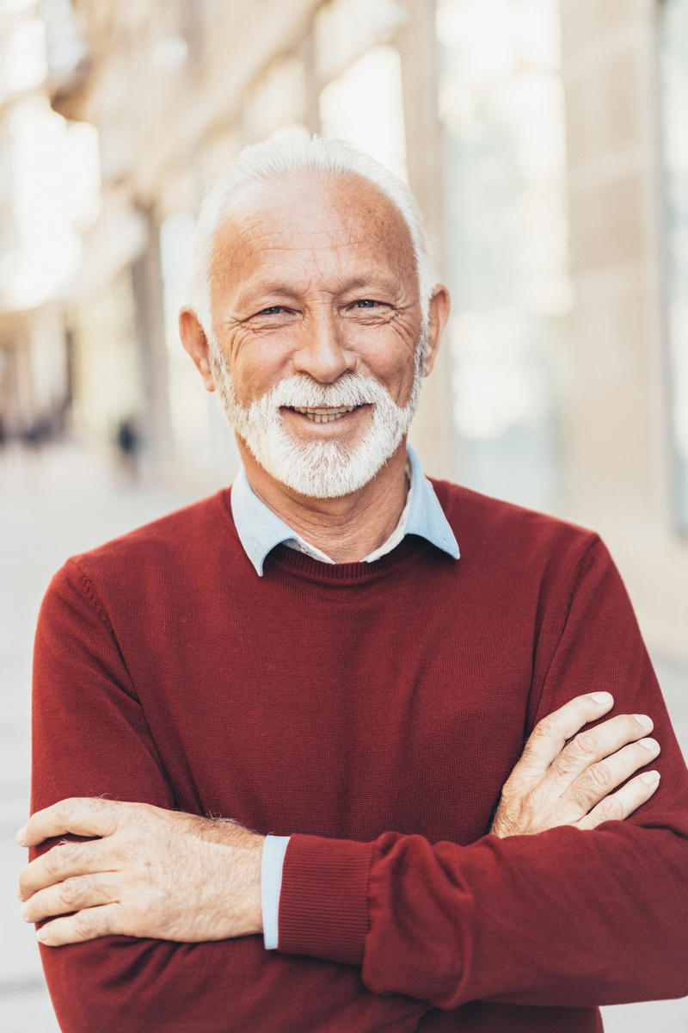
Buyer Persona
Bio: Khaled is in his sixties, retired and takes care of his health. He prefers experienced dentists, looks for special offers for the elderly, and looks for clinics that have contracts with insurance companies.
Goal: He want to maintain good dental health and get good health care
He is looking for a clinic that offers specialized services for the elderly.
Challenges: He may have some concerns about visiting the dentist
He search for a clinic close to his home.
Pain points: He suffers from diabetes and the complications associated with tooth extraction. He wishes to replace these teeth but is uncertain about whether to choose commercial implants or fixed bridge
KHALED
RETIRED ENGINEER

Slide 10
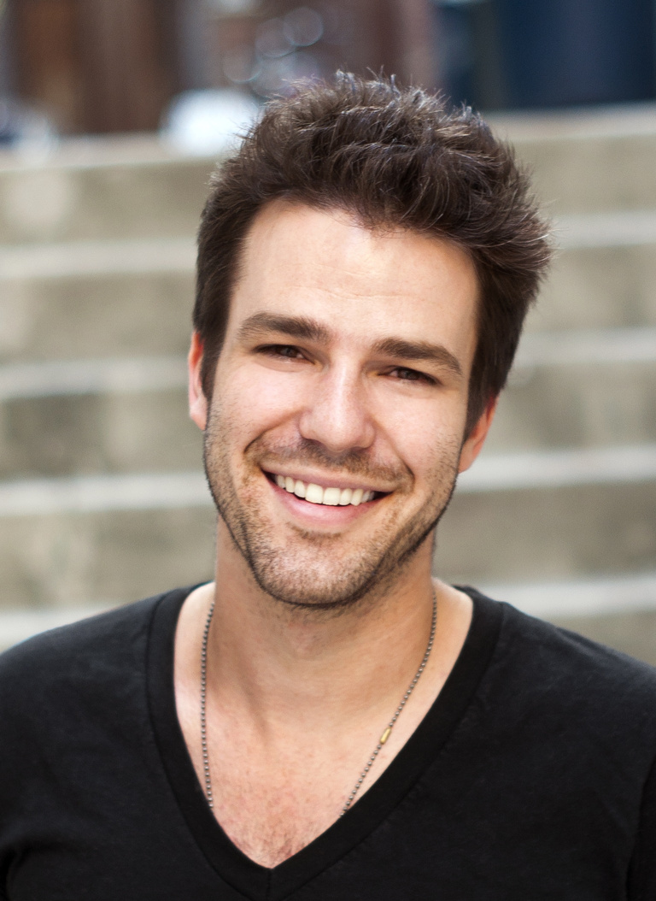
Buyer Persona
Bio: Ali is in his twenties, single uses social media to search for clinics, looks for offers and discounts, reads reviews, prefers to book online, and is influenced by friends’ recommendations.
Goal: Wanting to have an attractive smile to boost his self-confidence in social relationships, he is looking for a clinic that offers special offers for students.
Challenges: He cares about his dental health in general but may procrastinate visiting the doctor due to costs or fear. He has a limited budget. He prefers clinics that offer installments. He is looking for a clinic close to the university..
Pain points: He suffers from diabetes and the complications associated with tooth extraction. He wishes to replace these teeth but is uncertain about whether to choose commercial implants or fixed bridge
Ali
College Student

Slide 11
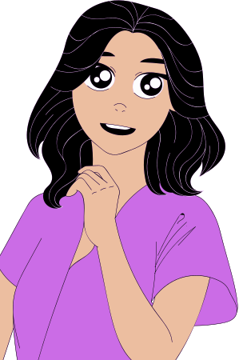
Buyer Persona
Bio: Nadia is in her 40s, a mother of four. She is graduated from university and she uses the internet to search for clinics Preferring those that provide quick and efficient services. She compares prices, prefers to book by phone,
Goal: She has time constraints, is looking for a clinic that is close to home and fits her budget, and prefers clinics that provide services for children
Challenges: She cares about her family's health, has regular checkups, and is looking for a clinic that provides comprehensive care for all family members
Pain points: She always has a fear of dental clinics that do not apply infection control standards, so she wants a clinic that applies infection control standards to preserve the health of her children.
Nadia
A mother

Slide 12
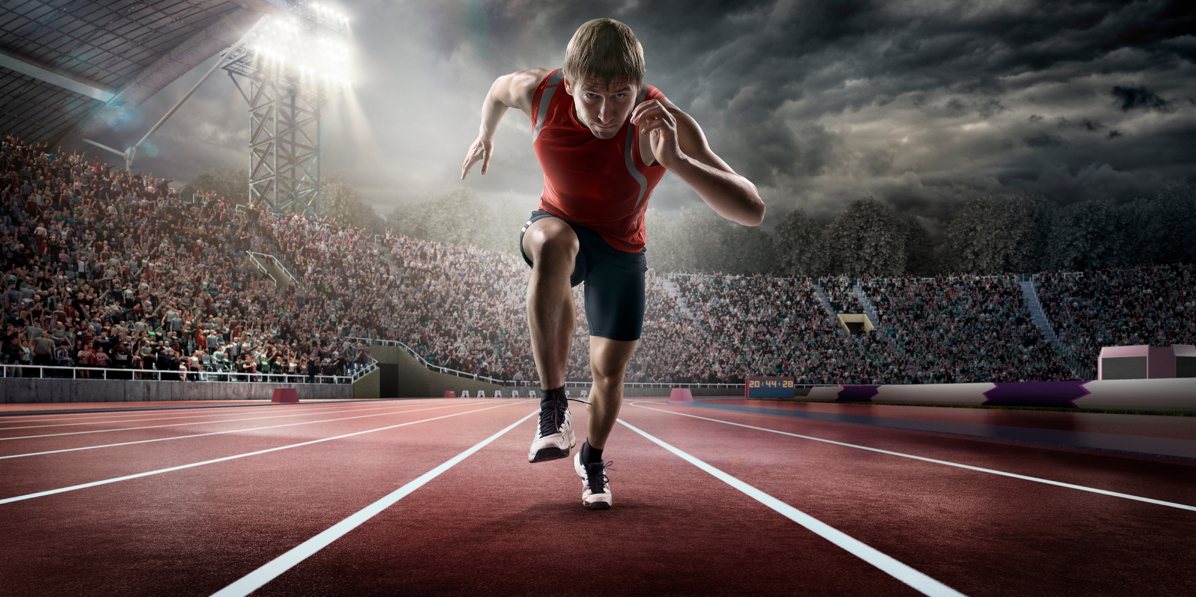
Buyer Persona
Bio:athlete in his 20s concerned about his physical health, searches for information online, seeks advice from coaches and fellow athletes, prefers clinics that use the latest technology and flexible appointments.
Goal: He may have damaged teeth due to playing sports, he is looking for a clinic that provides emergency services, preferably clinics located near training locations
Challenges: Wants to maintain oral health to ensure excellent athletic performance, looks for quick and effective solutions, may have a busy training schedule..
SAMEH
Pain points: He has sustained a broken tooth while exercising and seeks to obtain a crown that is both affordable and Looks natural.
Athlete

Slide 13
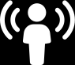
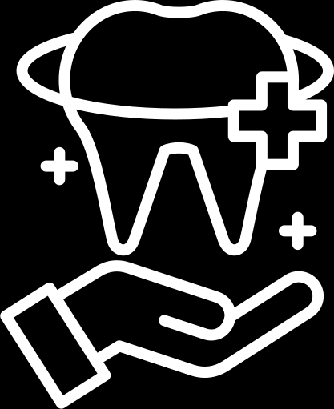
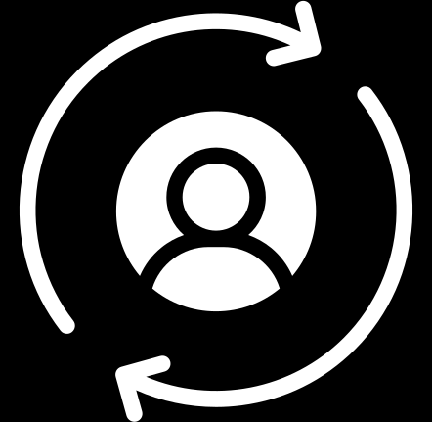
Objectives
Increasing brand awareness by 30% in the next 3 months through digital marketing platforms.
Increase revenue by 15% within the next 3 months by promoting high-value services (e.g., implants, cosmetic dentistry).
Aim to increase patient visits by 20% in the next 12 months by new patients and retargeting previous patients

Slide 14
COMPETITOR ANANLYSIS

Slide 15

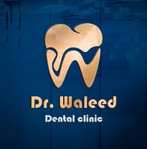


Competitor Analysis
Number of Experience Year | Clinic | Date of page creation
A qualified dentist with about 35 years experience |  | The page was created on June 2018
A qualified dentist with about 15 years experience. |  | The page was created on September 2023.
A qualified dentist with about 25 years experience |  | The page was created on April 2014

Slide 16
Competitor Analysis
Strengths
Balanced Content
Good Engagement.
Special Discounts.
Weakness
Moderate Posting Frequency but need to be regular
High pricing .

Slide 17
Competitor Analysis
Strengths
Weakness
- High Engagement.
-Frequent Posting.
-Doctor has another
clinic in Turkey.
-Over posting.
-No direct contact.
-No patients review.
-High services price.

Slide 18
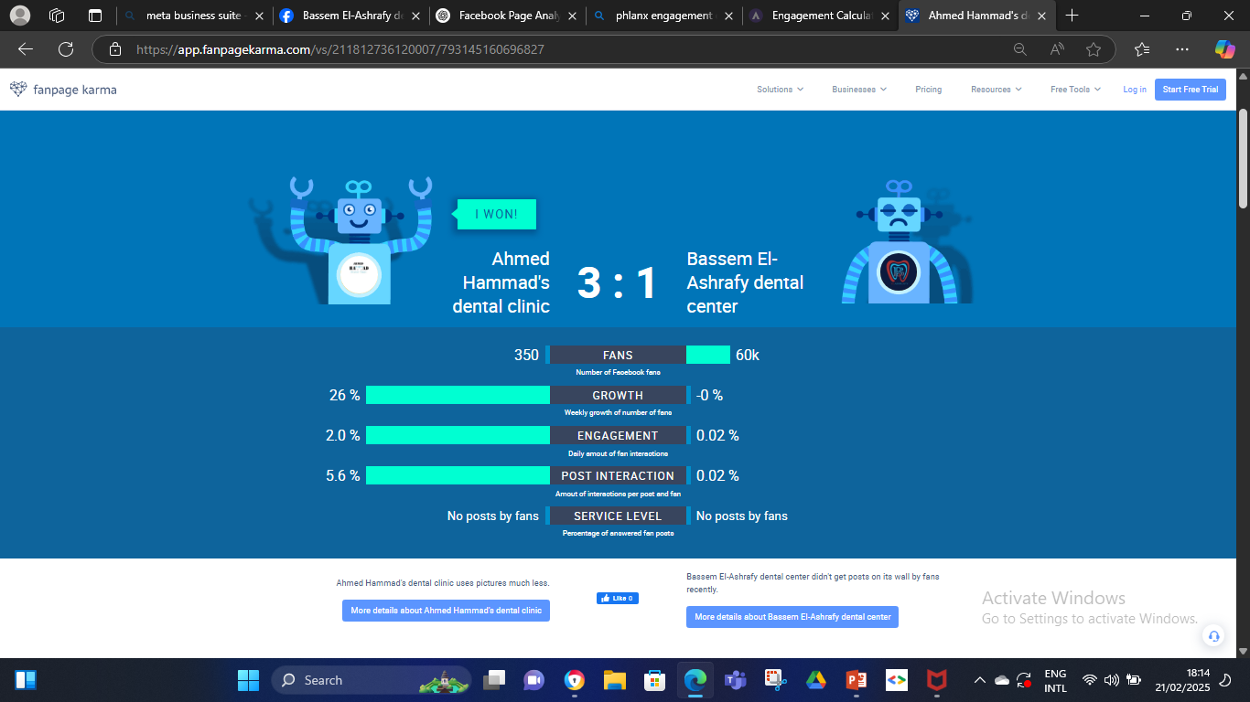
Competitor Analysis

Slide 19
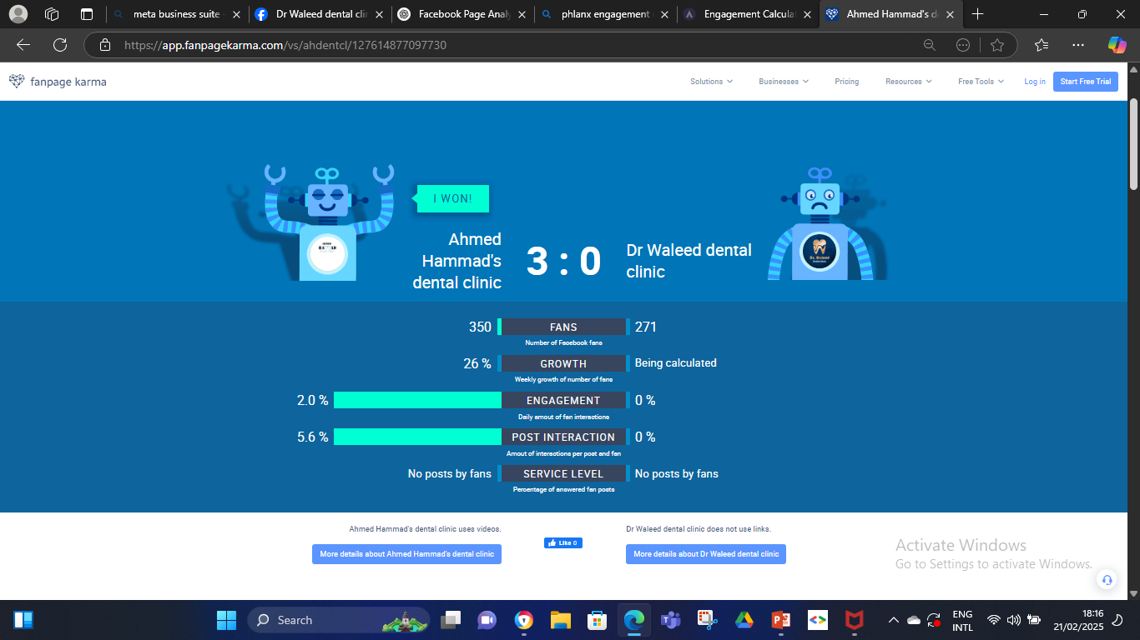
Competitor Analysis

Slide 20
Strategy

Slide 21
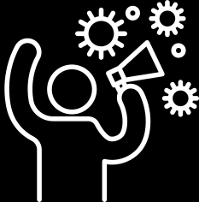
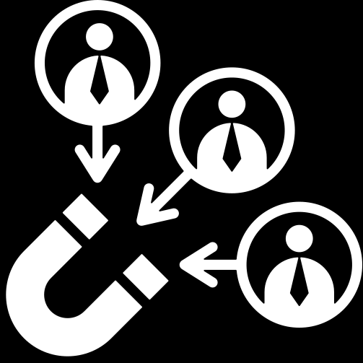
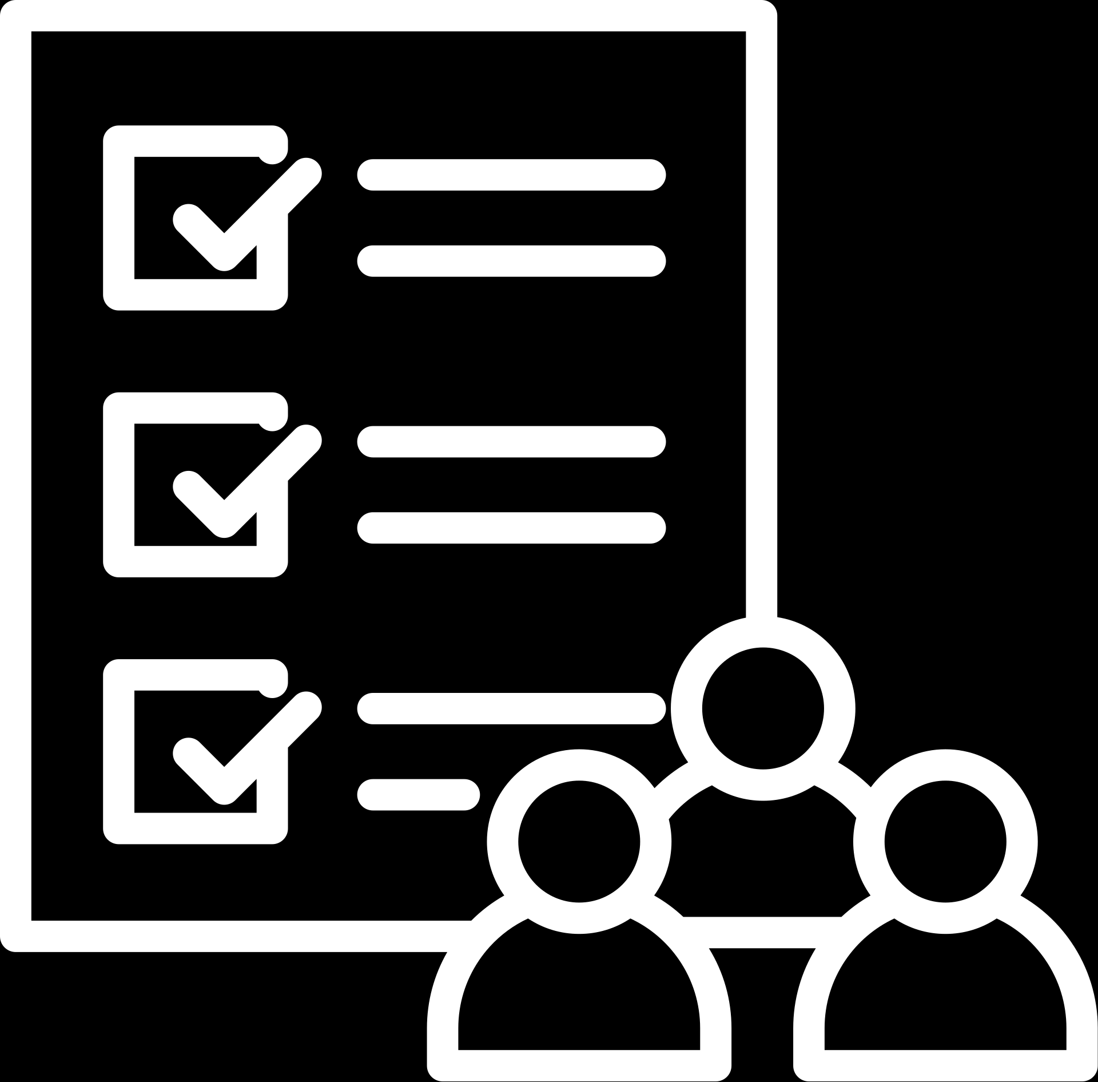

Strategy Timeline
Phase 2
(2nd and 3rd month)
Phase 3
(3rd month)
Phase 1
(1st month)
Focus on patient retention strategies, customer loyalty programs, and growing the clinic’s reputation through patient reviews, educational and promotional and before and ater posts
Evaluate the success of the marketing tactics and refine them based on patient feedback and marketing metrics.
Focus on building a strong online presence through Educational and promotions conents

Slide 22


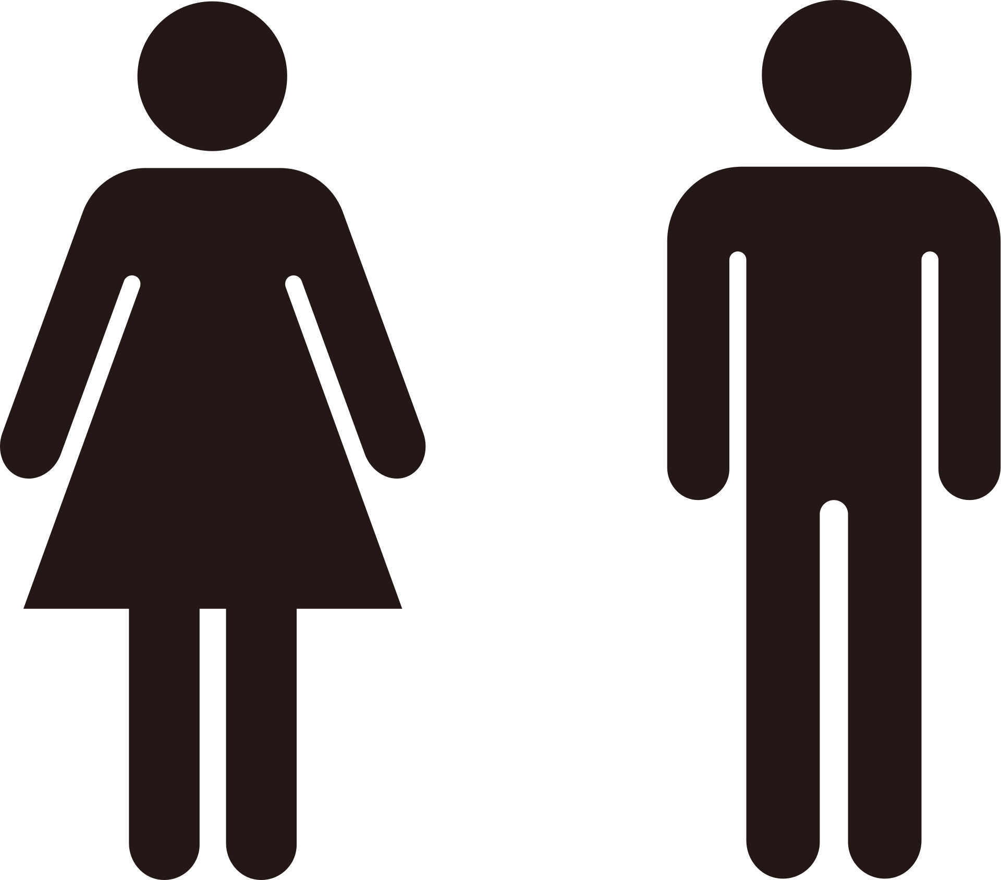





Digital Platforms
According to the market and audience analysis of the clinics in Alexandria we found that most patients search for dentists mostly on facebook and sometimes on instagram , our audience was including all males and females , single and married , age from 18-60 years
Single
Married
Males and females
Teenage
Adults
Elders
Facebook
Instagram

Slide 23
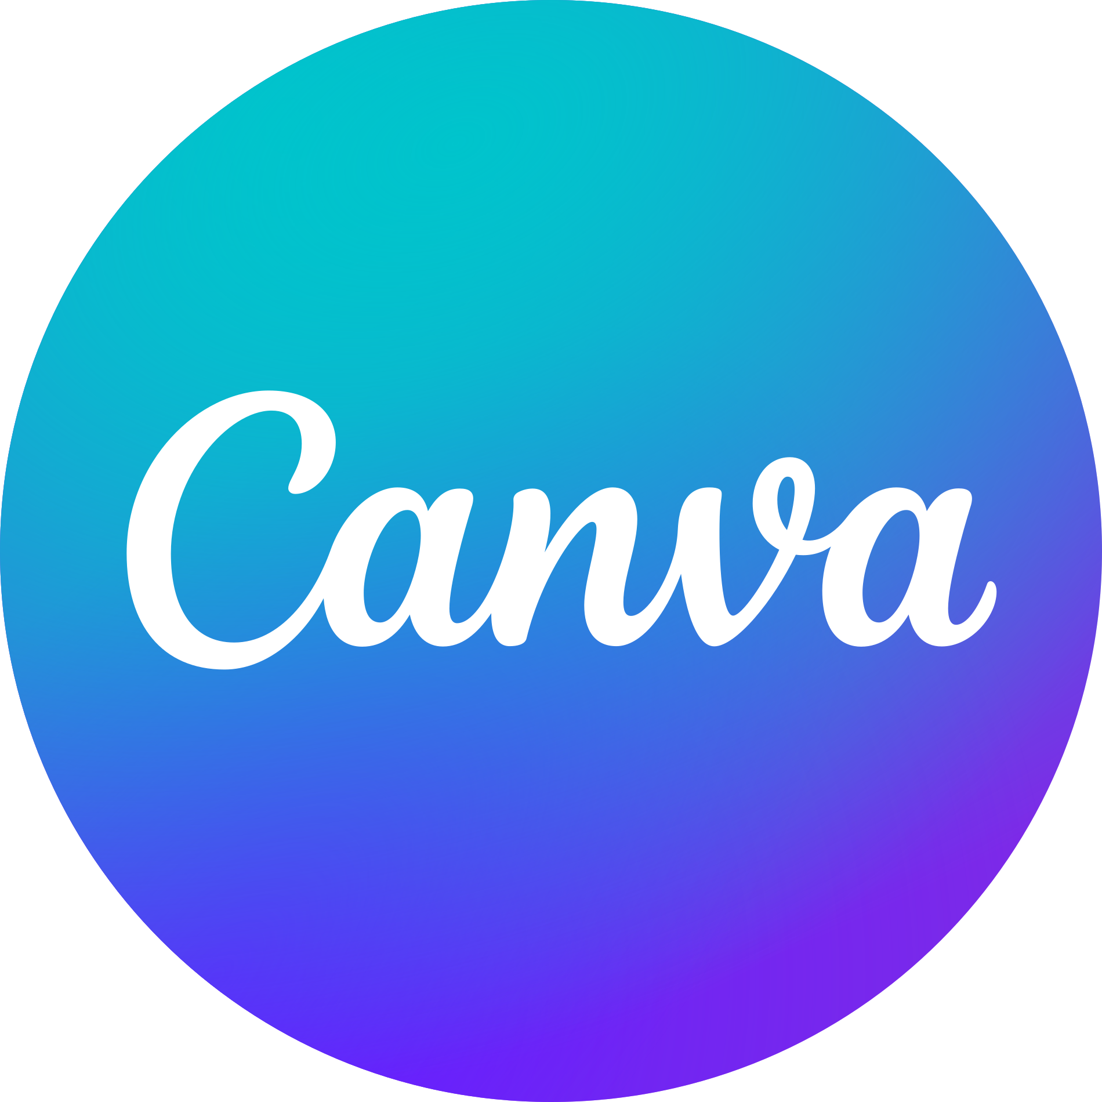


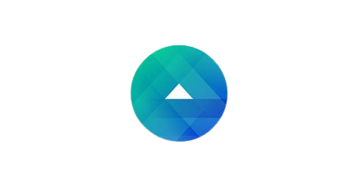


Applications used
We used these applications and sites during the projects steps
Canva:
For designing social media posts, videos and ads creative
Fanpage Karma:
Used for
competitor analysis
Meta Business Suite:
For managing and scheduling Facebook and Instagram posts
Capcut:
For editing videos and promotional videos
Google drive
Used for storing reports, presentations , content plans and sharing files.
Meta Ads Manager:
For running Facebook and Instagram Ads

Slide 24



Advertisment
Budget
We defined the budget for the ads with 1000 LE divided into 2 ads types
Awareness
Engagement
To increase awareness of the clinic name and location with educational posts
To increase the number of followers and likes to the page and retain the old patients.

Slide 25
CONTENT CALENDAR

Slide 26
Content Calendar
DECEMBER
Saturday | Sunday | Monday | Tuesday | Wednesday | Thursday | Friday
 | فيديو جير الأسنان ومضاعفاته | 2 | 3 | خصم خاص علي التبييض | ضرس العقل ومشاكله | فيديو حالة مريض قبل وبعد
أسباب نزيف اللثة | 8 | أسنان الأطفال والاهتمام بها | بوست دعائي زراعة الاسنان | 11 | ليه لاوم تركب بعد الخلع | 13
ضحكتك حتنور التركيبات الثابتة | 15 | 16 | تركيب فص هدية مع التبييض | خصم 20% علي جميع الخدمات | فيديو بخدمات العيادة | تخصصات العيادة
مشاكل خلع الاسنان لكبار السن | 22 | حقائق واكاذيب عن طب الاسنان | ألم العصب | 25 | حقائق وااذيب عن طب الاسنان | 27
28 | سكرك مضبوط سنانك مضبوطة | تهنئة بالعام الجديد | 31
CONTENT TYPE
PLATFORM
Educational
Promotional
Facts and Muth
testimonial
Before and After
Faceboook
Instagram

Slide 27
Content Calendar
JANUARY
Saturday | Sunday | Monday | Tuesday | Wednesday | Thursday | Friday
 |  |  |  | 1 | المضادات الحيوية وتاثيرها علي الاسنان | 3
حساسية الأسنان | 5 | معلومة سريعة | 7 | 8 | حقائق واكاذيب | 10
زراعة الأسنان ومميزاتها | 12 | فيديو عن تنظيف الأسنان | 14 | 15 | فطريات الفم وعلاجها | 17
الحشوات التجميلية | 19 | أمتي الاسنان اللبنية بتتبدل | 21 | 22 | المخاوف من طبيب الأسنان | 24
الغلورايد والمعجون | 26 | 27 | 28 | 29 | 30 | 31
CONTENT TYPE
PLATFORM
Educational
Promotional
Facts and Muth
testimonial
Before and After
Faceboook
Instagram

Slide 28
Content Calendar
FEBRUARY
Saturday | Sunday | Monday | Tuesday | Wednesday | Thursday | Friday
التركيبات المتحركة ومميزاتها | 2 | 3 | فيديو حالة قبل وبعد | 5 | تسوس اسنان الأطفال | 7
حساسية الأسنان | 9 | 10 | تركيب فص هديه مع التبييض | 12 | ريفيو من مريض سابق | 14
فيديو طريقة غسل الأسنان | 16 | 17 | صورة لعيادة والدكتور | 19 | حقيقة واكاذيب | 21
تركيبات الاسنان | 23 | 24 | حشو الليزر | 26 | الأمراض العضويه التى تؤثر على صحة الأسنان واللثة | 28
CONTENT TYPE
PLATFORM
Educational
Promotional
Facts and Muth
testimonial
Before and After
Faceboook
Instagram

Slide 29
Content Calendar
MARCH
Saturday | Sunday | Monday | Tuesday | Wednesday | Thursday | Friday
CONTENT TYPE
PLATFORM
Educational
Promotional
Facts and Muth
testimonial
Before and After
Faceboook
Instagram

Slide 30
Posts Sample

Slide 31
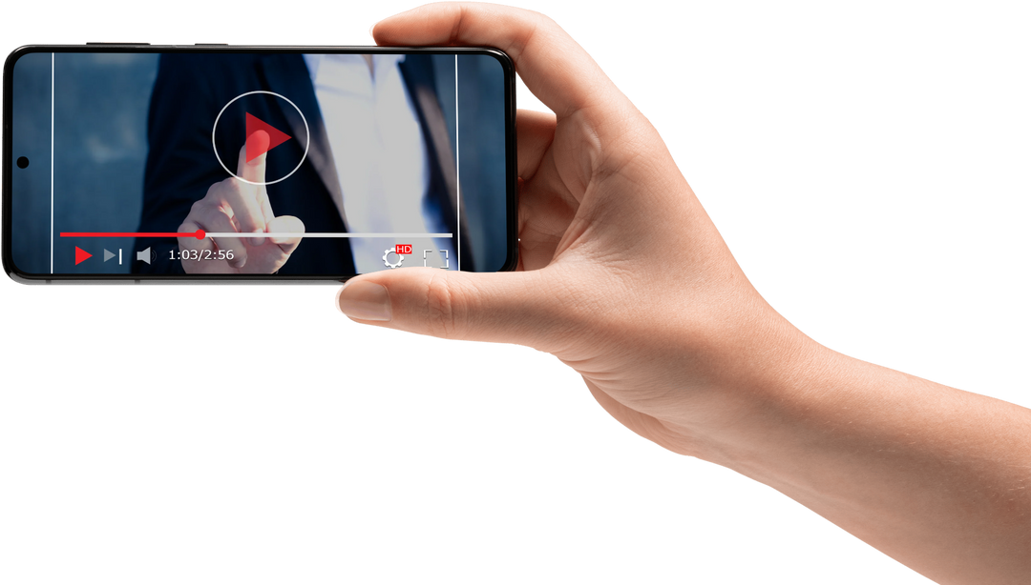
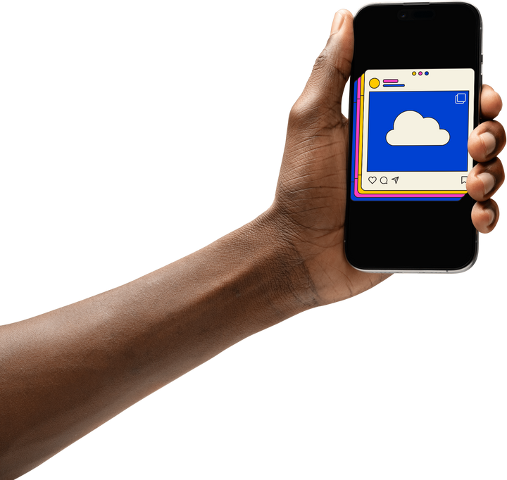
Posts Samples
Our posts include image posts ,reels , stories and videos
Each type of them include educational, promotional before/after and testimonial.

Slide 32
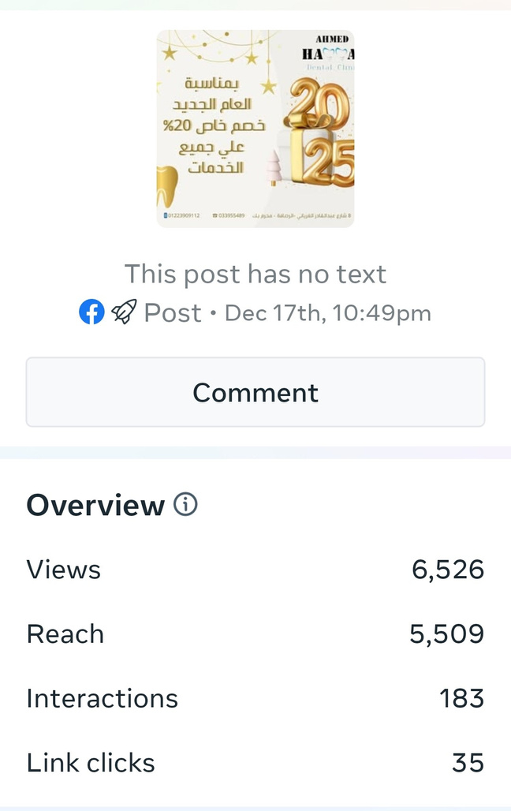
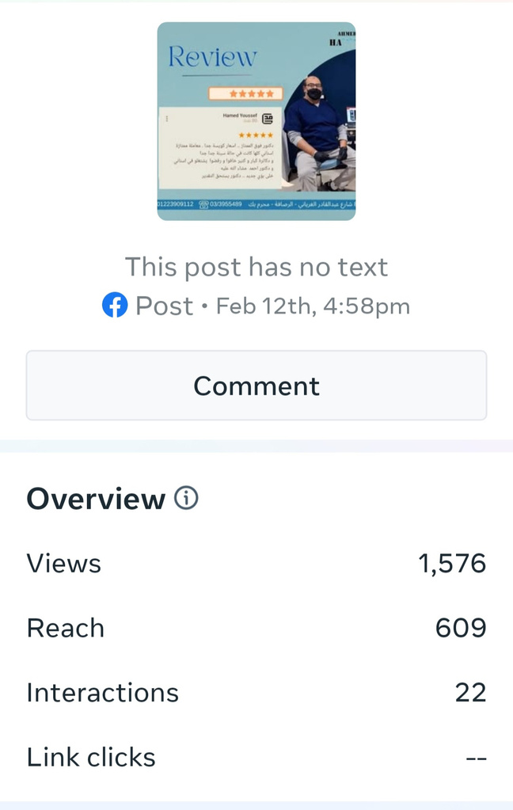
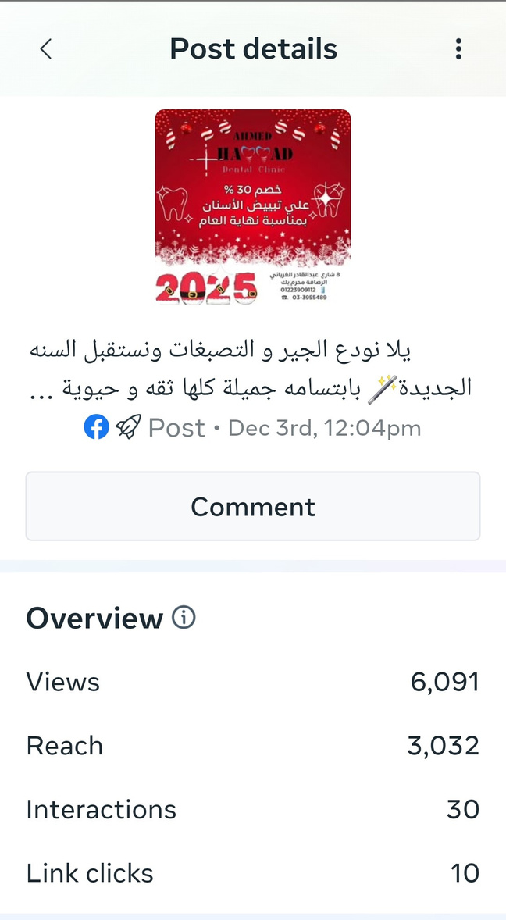
Facebook Posts Sample
PROMOTIONAL
TESTIMONIAL
PROMOTIONAL

Slide 33
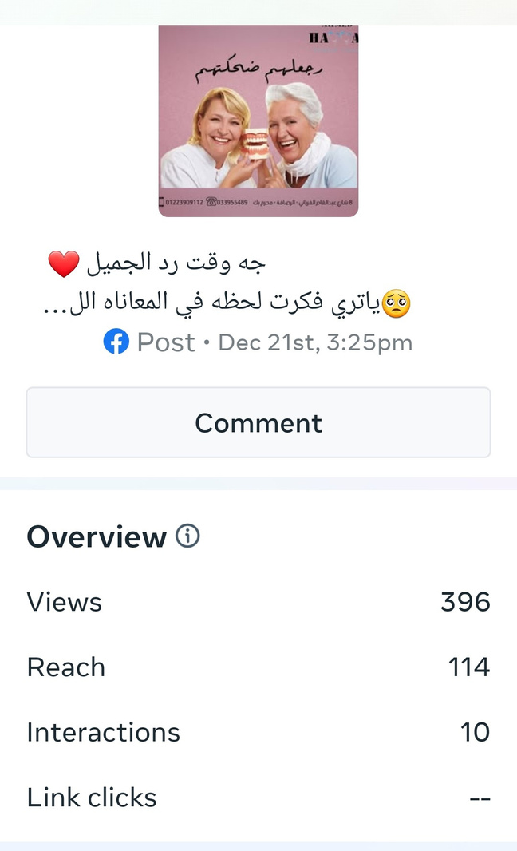
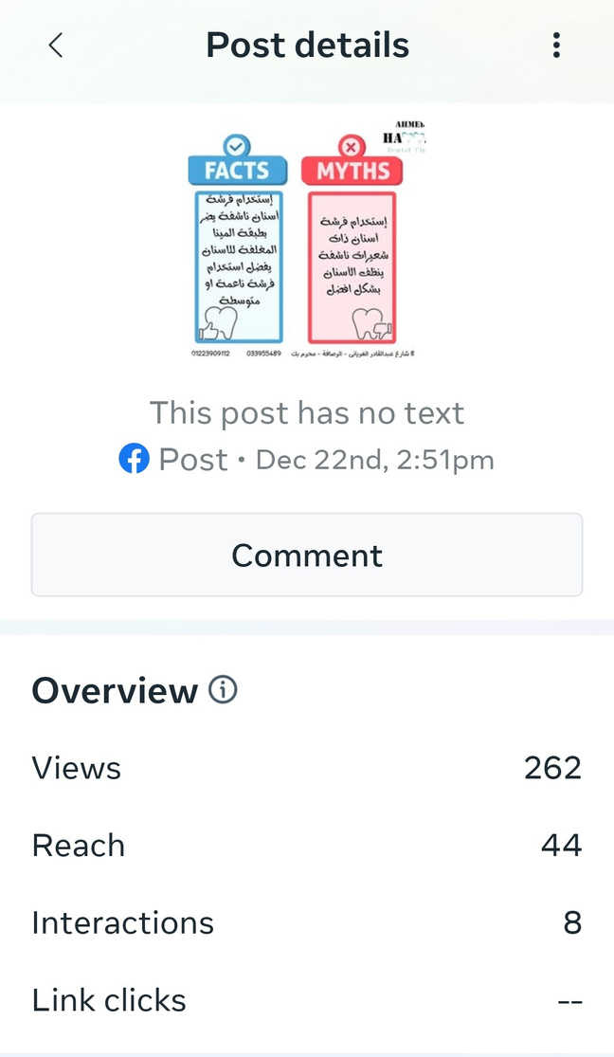
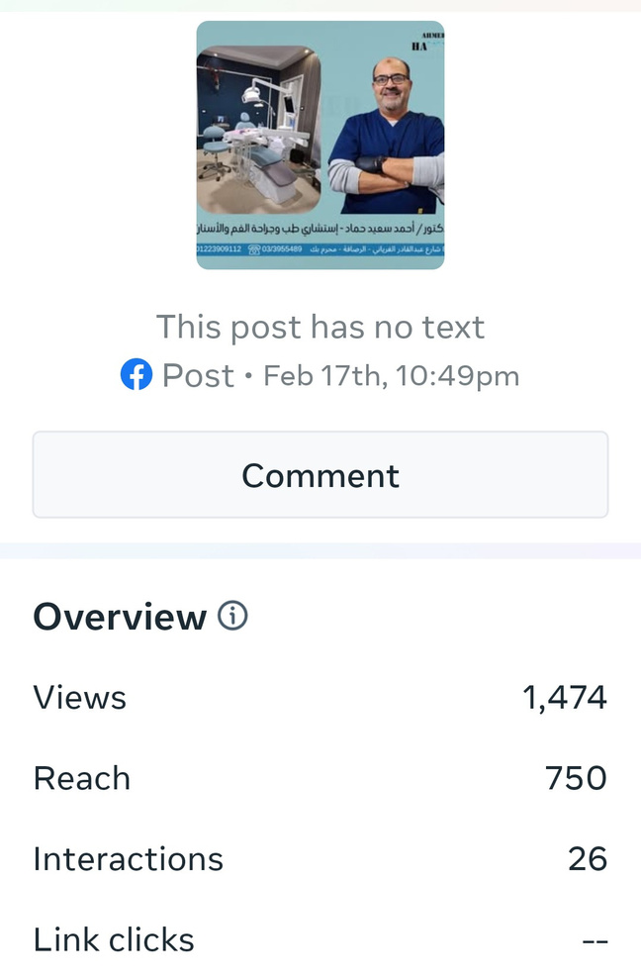
Facebook Posts Sample
EDUCATIONAL
EDUCATIONAL
PROMOTIONAL

Slide 34
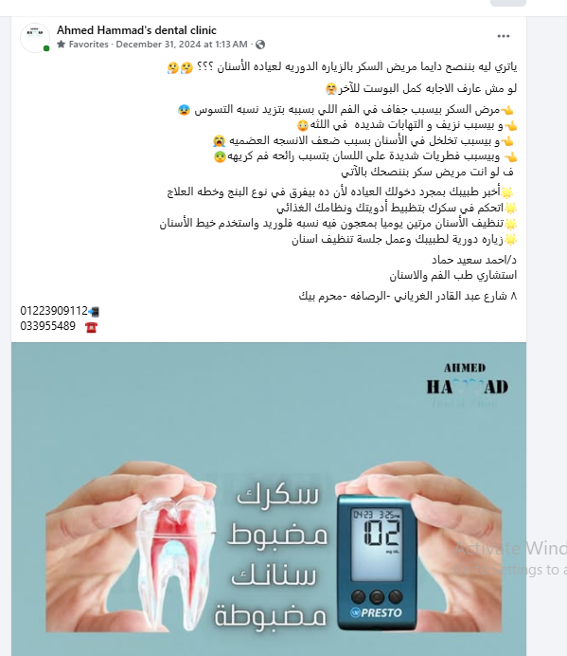
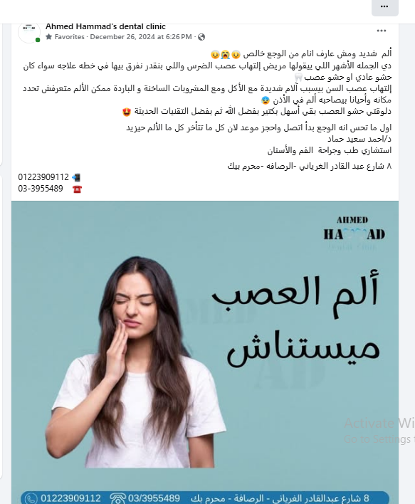
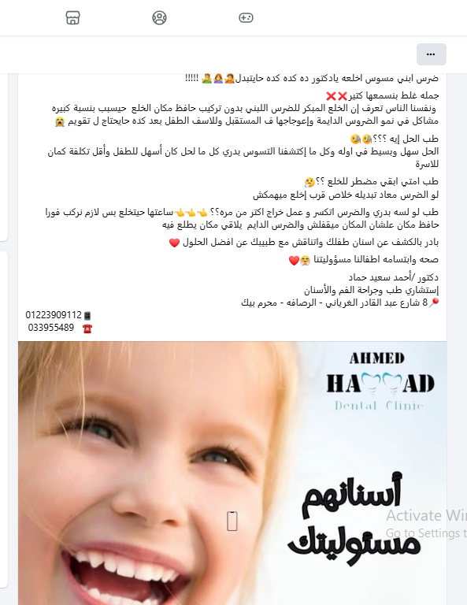
Facebook Posts Sample
CONTENT SAMPLES

Slide 35
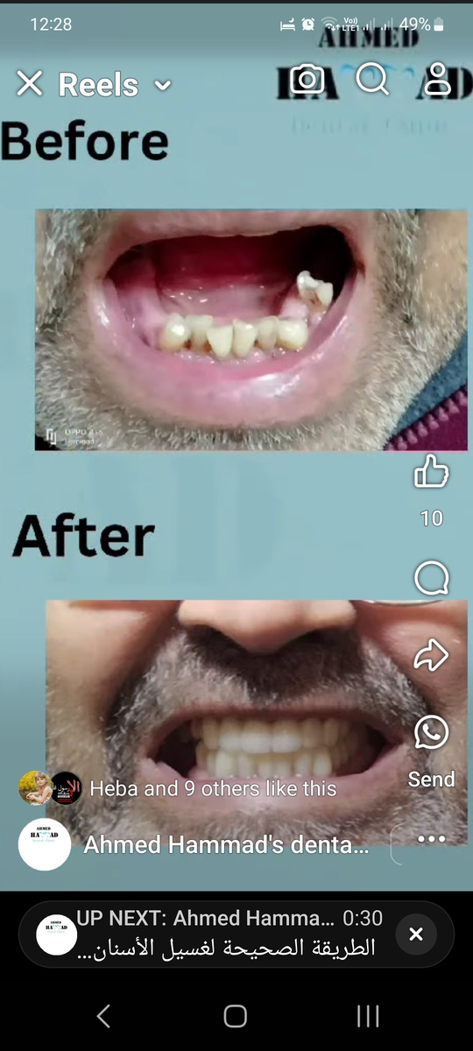
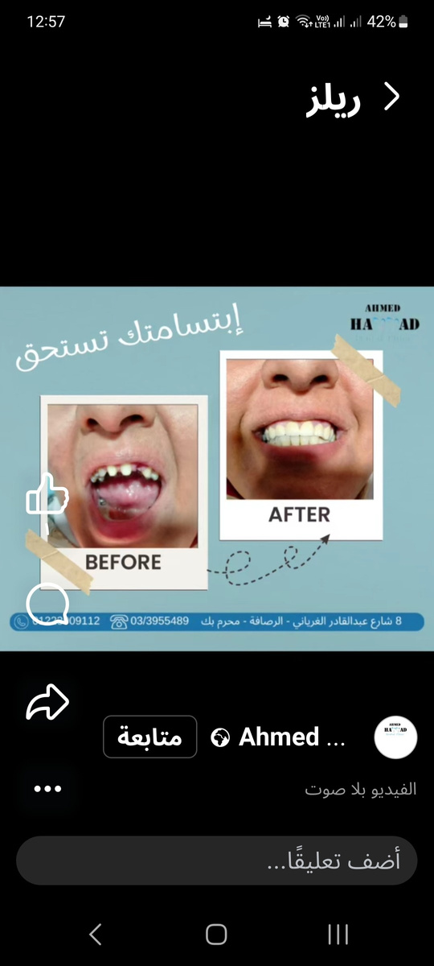
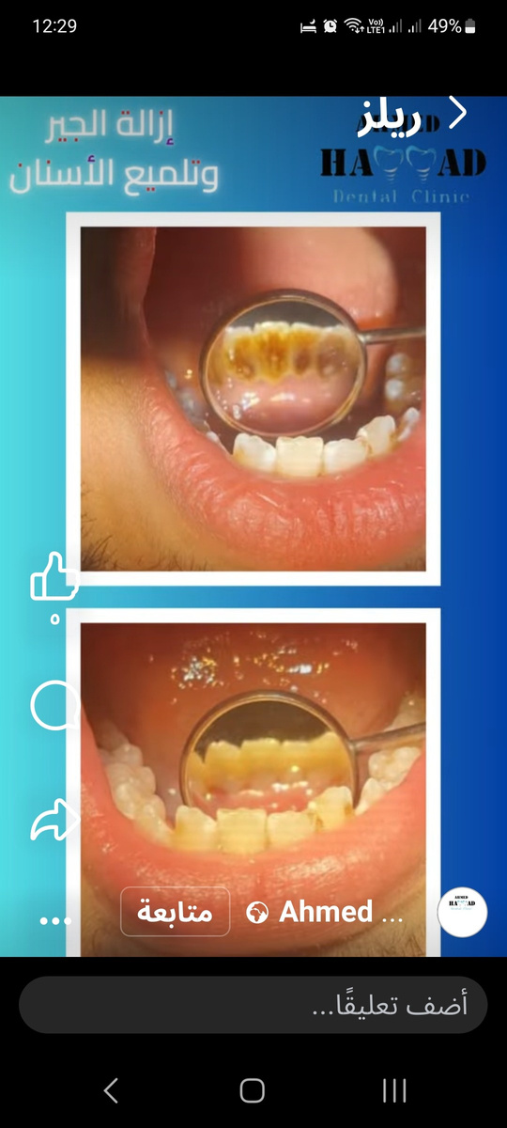
Facebook Posts Sample
Before and after posts were published on facebook and instagram as posts, reels and stories

Slide 36
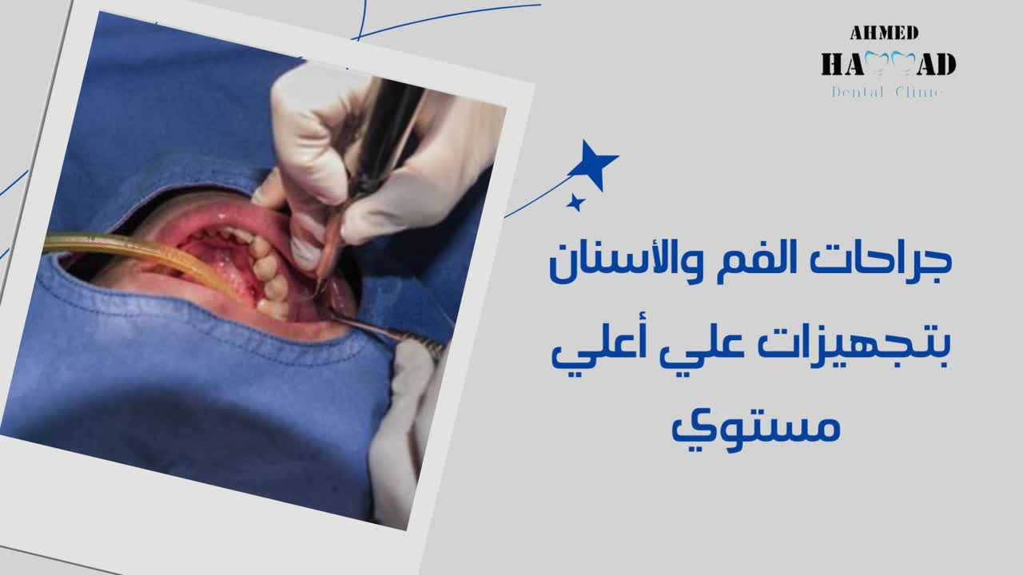
Facebook Posts Sample

Slide 37
PAGE PERFORMANCE

Slide 38
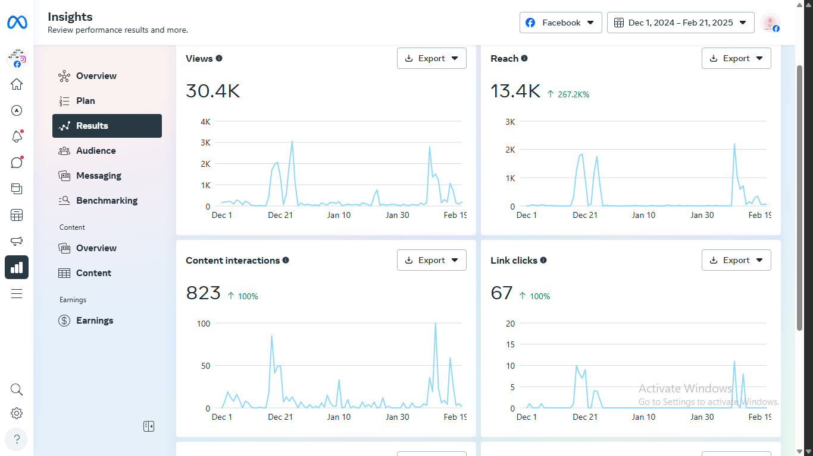
Page Performance
The chart show
the performance
of the page
starting from
1 Dec to 22 Febr

Slide 39
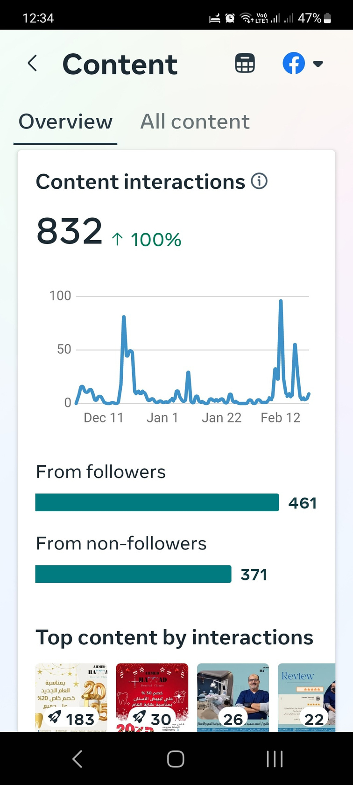
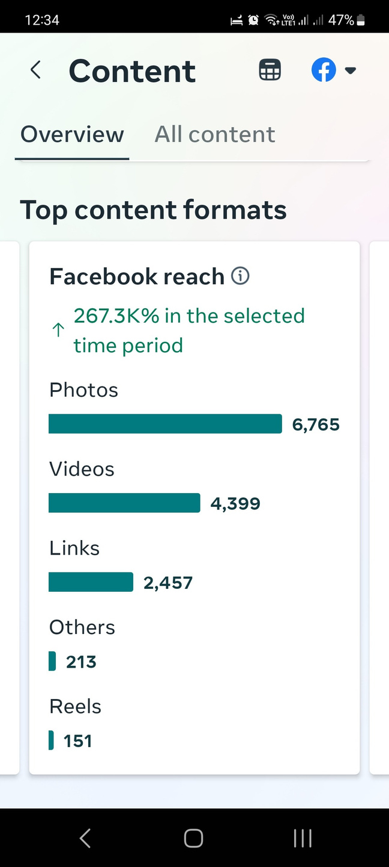
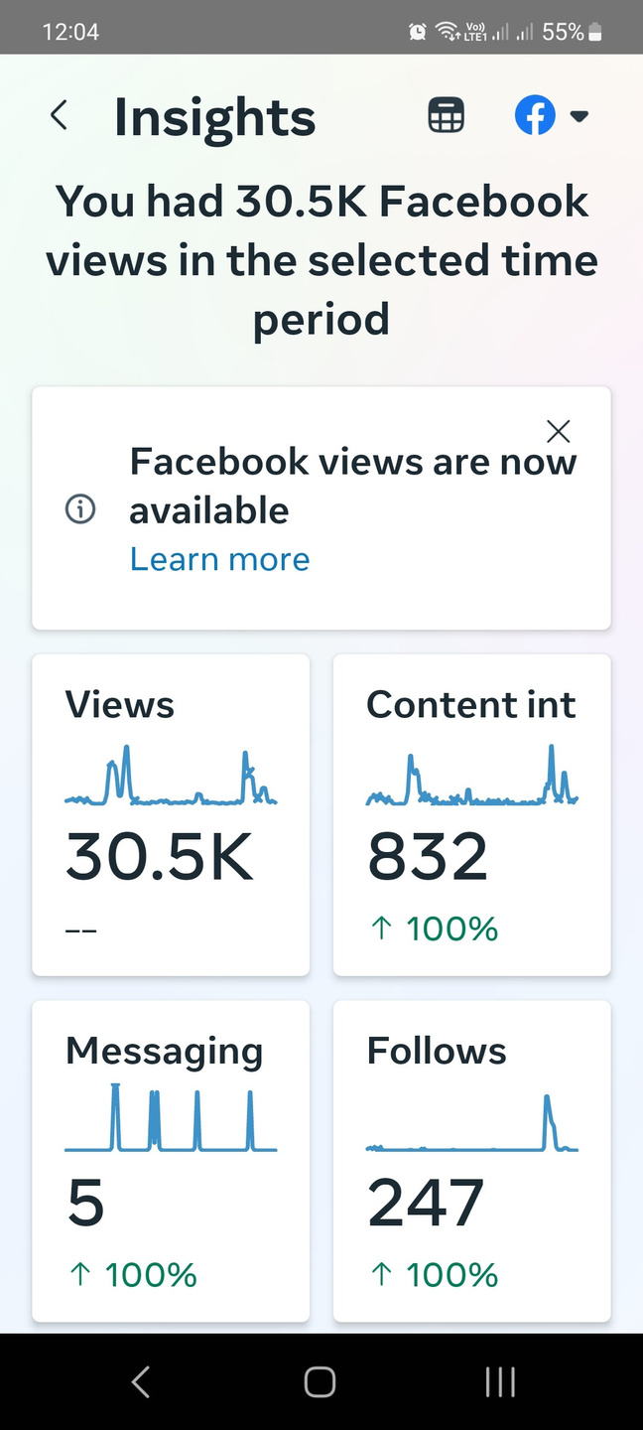
Content Analysis

Slide 40
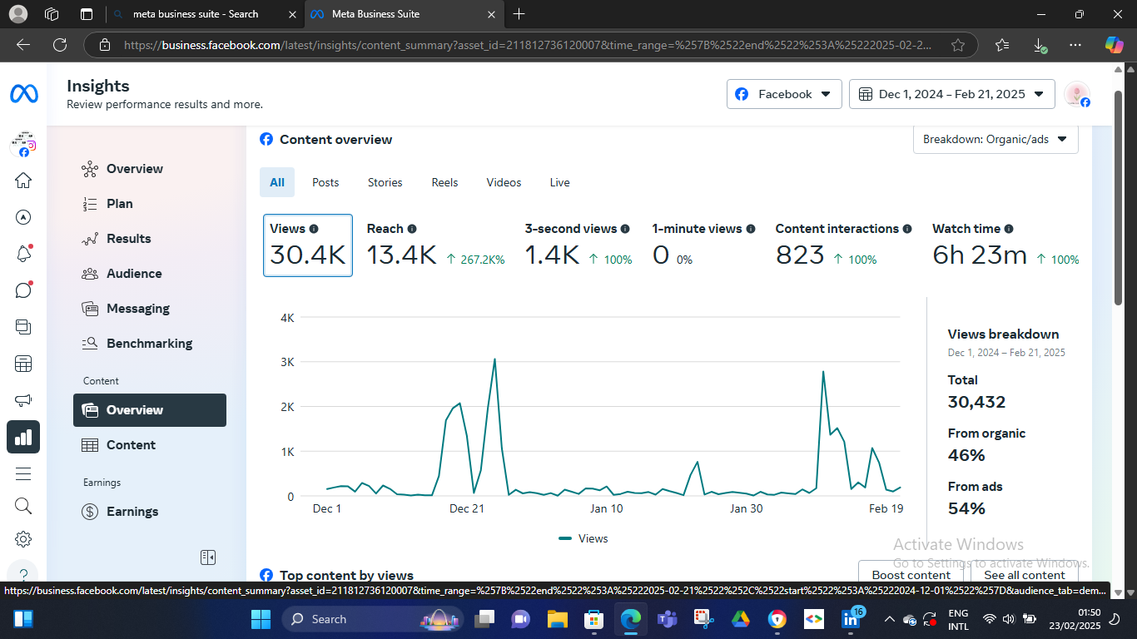
Content Overview

Slide 41
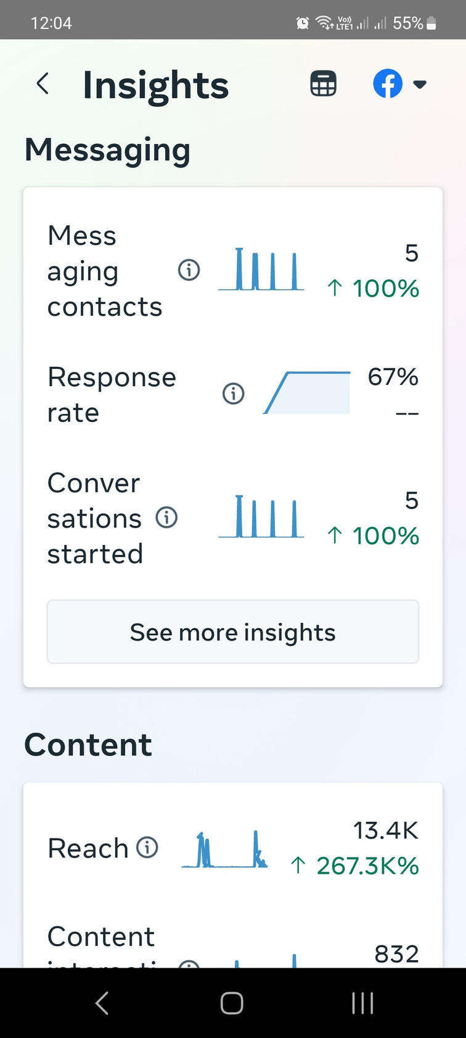
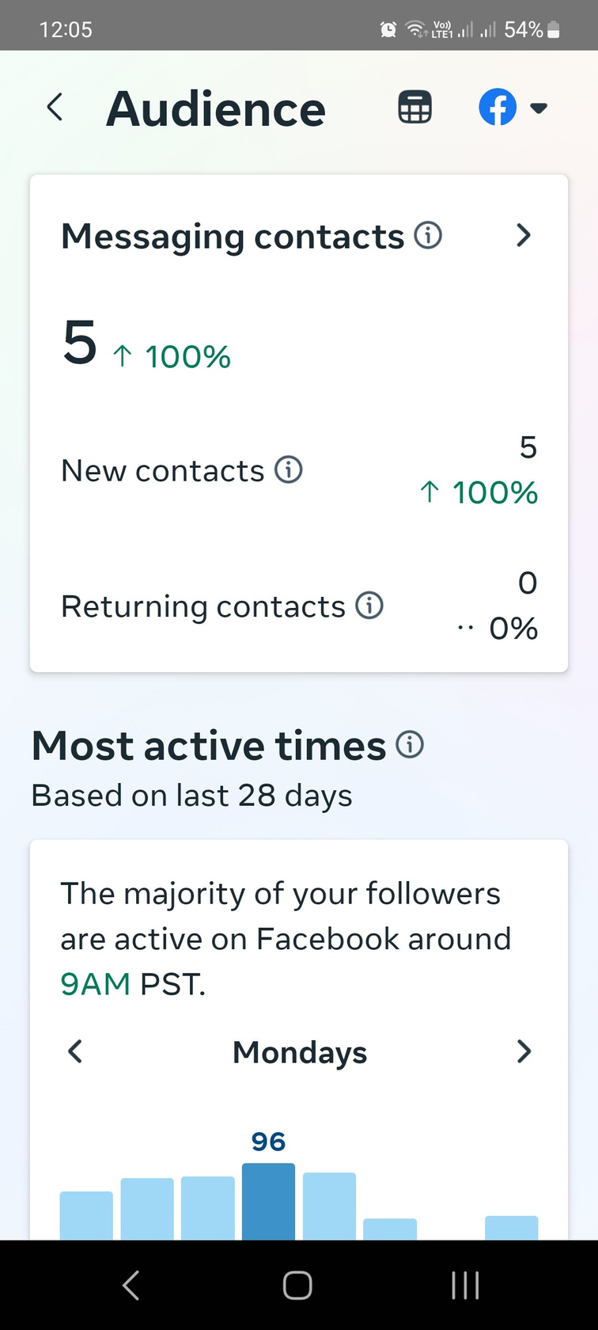
Messeges Analysis

Slide 42
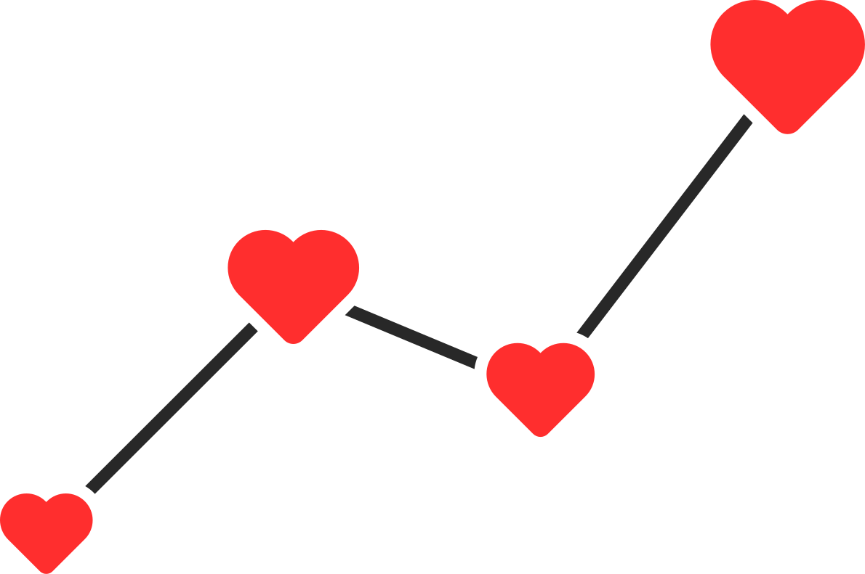
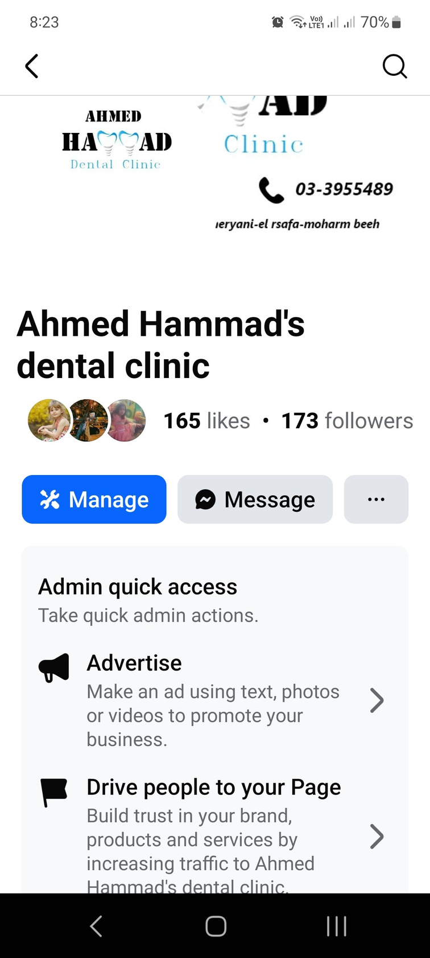
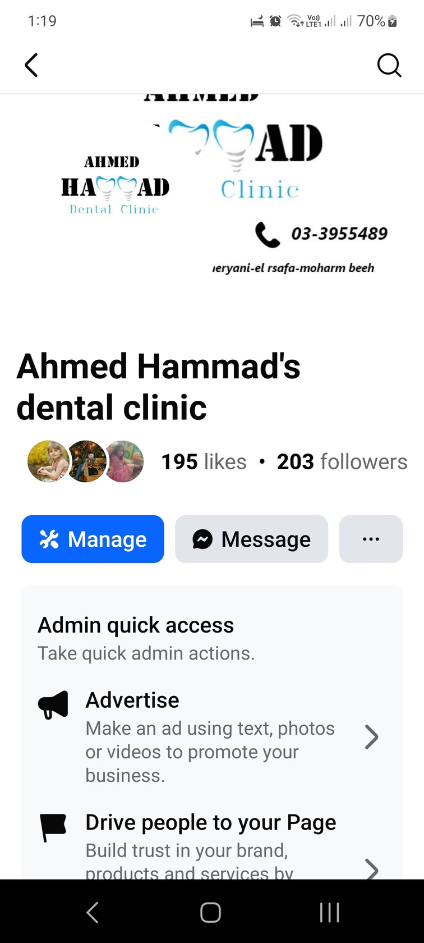
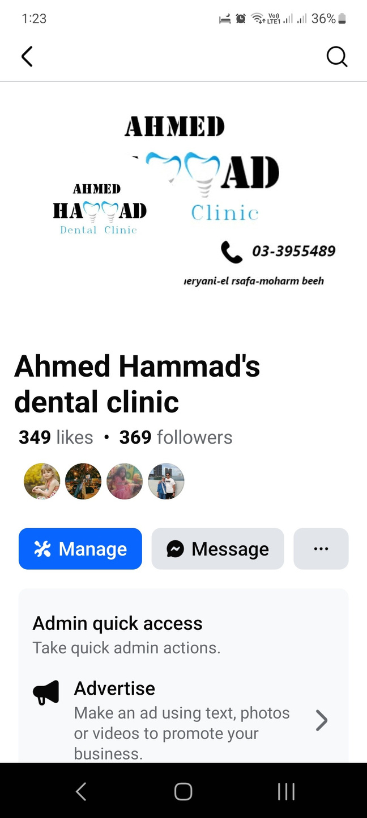
Page followers & likes
We increased followers by from 173 to 369 by 113.3%
while page likes increased from 165 to 349 by 111.5%
W

Slide 43
CAMPAIGN MANAGMENT

Slide 44
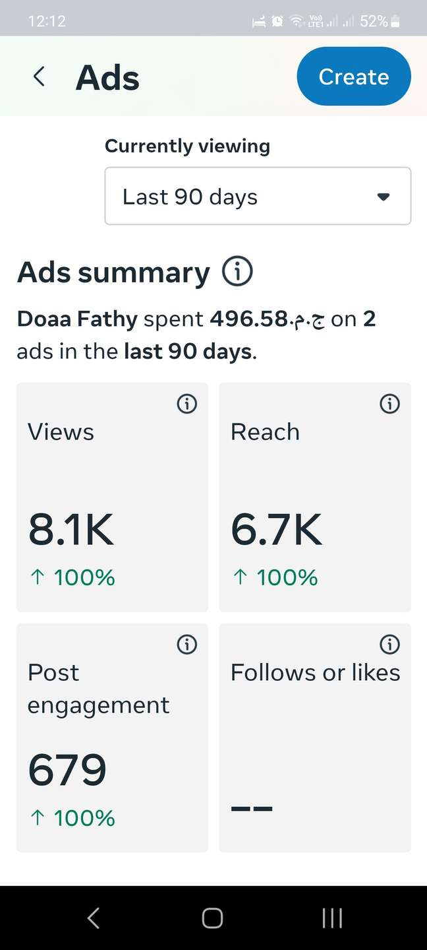
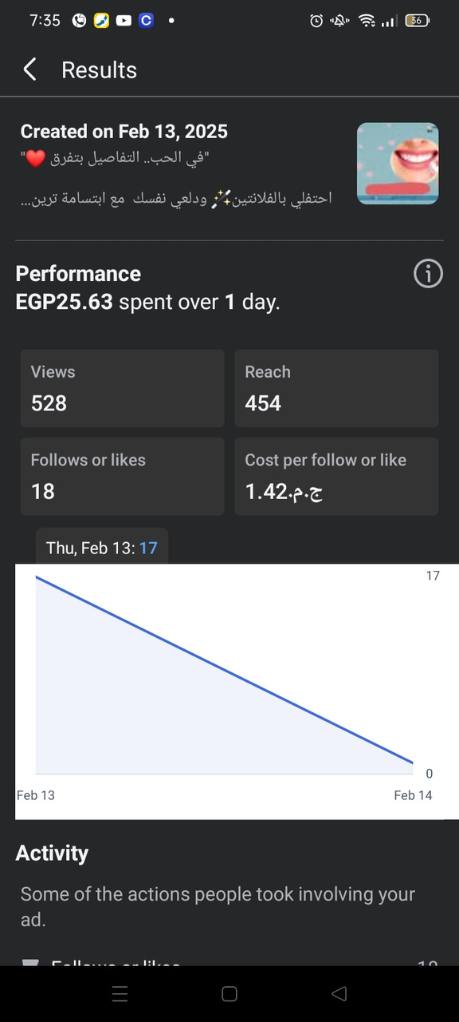
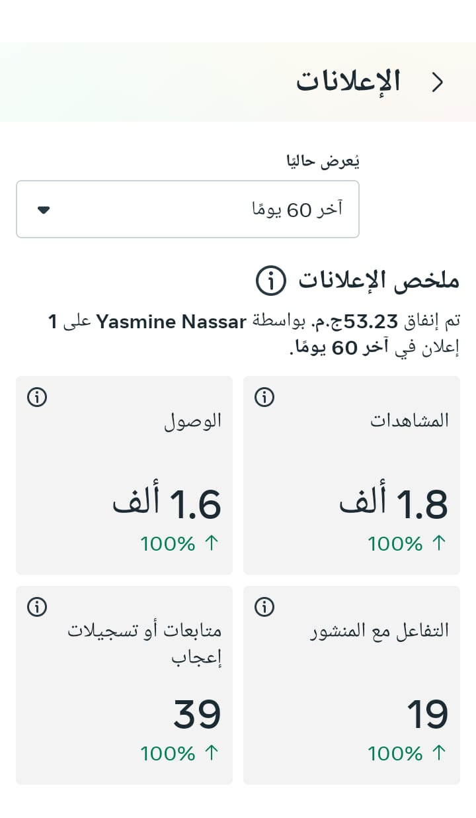
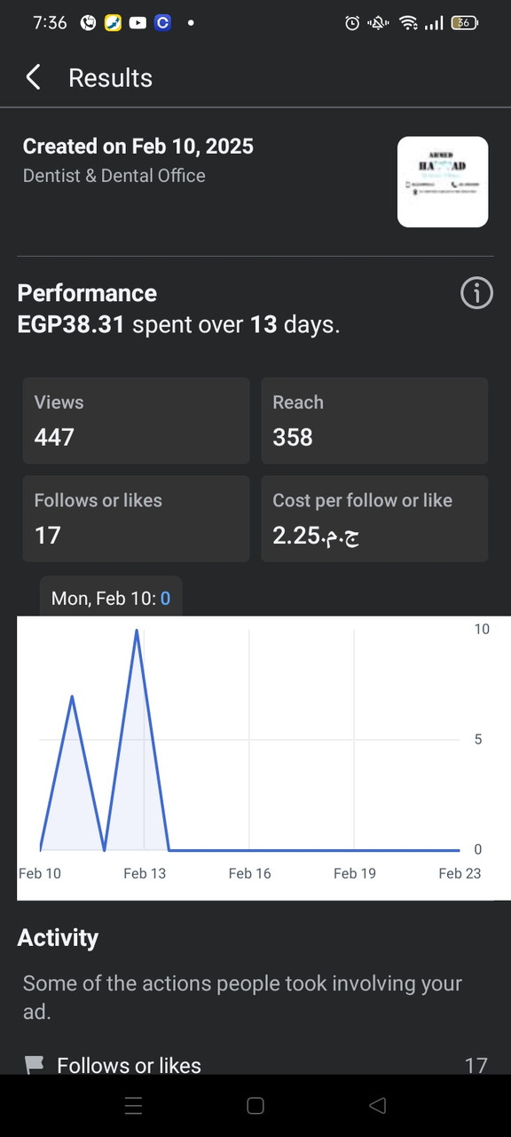
Facebook Campaigns

